Slide 1
Welcome

Slide 2
Index
1 | Introduction
2 | Industrial Information
3 | Company Information
4 | My Internship Project
5 | Work Sample
6 | Conclusion

Slide 3
Introduction
Web development refers to the process of building and maintaining websites and web applications. It involves various disciplines such as front-end development, back-end development, and web design, which work together to create a functional and visually appealing website.

Slide 4
Industrial Information
Name | Comtranse Technology Pvt.Ltd Kolhapur
Director | Miss. Trupti Gaikwad-Devane
Start up | 23 January 2023
Work | UI and UX Development And Website Development
Turn Over | 5,00,000
Best Project | Web Development
Training Date. | 23 January 2023 To 08 February 2023
Site | www.comtranse.in

Slide 5

Company Information
Name | Comtranse Technology Pvt.Ltd Kolhapur
Address | NCC Bhavan Kolhapur, Near Shivaji University Gate no 8, Sky Ville Apartment Kolhapur. Pincode - 416008
Contact | 9623510789
About | Comtranse Technology Pvt.Ltd Kolhapur team of passionate people whose goal is to improve everyone's life through disruptive products. They build great products to solve business problems. Their products are designed for small to medium size companies willing to optimize their performance.
Services | Software Development, Web Development , Mobile App Development, And UI/UX Design

Slide 6
My Internship Project
Web Development ?
Web development is the process of creating and maintaining websites and web applications.
It involves various technical and non-technical disciplines, such as front-end development, back-end development, web design, content creation, and website management.
Front-end development involves creating the user interface of a website, such as the layout, design, and interactive elements.
Back-end development focuses on creating server-side infrastructure and handling data management, such as setting up a server, database, and APIs.
Web design involves creating the visual layout of a website and optimizing it for user experience, such as choosing color schemes, fonts, and image placement.

Slide 7
UI And UX ?
UI stands for User Interface, which refers to the visual design and layout of digital products such as websites, mobile apps, and software applications. It encompasses the colors, typography, icons, and other graphical elements that users interact with when using a digital product.
UX stands for User Experience, which refers to the overall experience a user has when interacting with a digital product. It includes everything from the ease of use and navigation to the emotional response that the product evokes in the user.
While UI and UX are often used interchangeably, they are distinct concepts that work together to create a successful digital product. UI focuses on the aesthetics and functionality of the product, while UX focuses on the overall user experience, including how easy the product is to use and how well it meets the user's needs.
In summary, UI is about the look and feel of a digital product, while UX is about the overall user experience of that product. Both UI and UX are essential to creating a successful digital product that users enjoy and find easy to use.

Slide 8
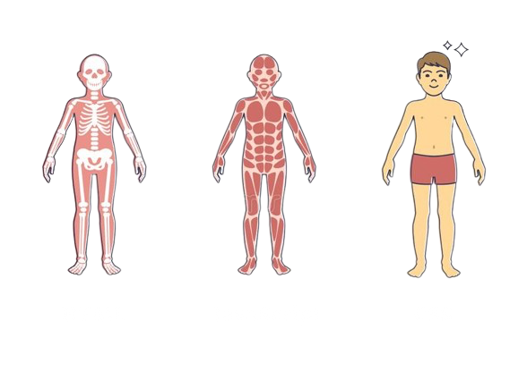
HTML, CSS, And JavaScript ?
HTML stands for Hypertext Markup Language and is used to create and structure the content of web pages. It uses tags to define different elements of a web page, such as headings, paragraphs, images, and links. HTML provides the foundation for building web pages and is an essential part of web development.
CSS stands for Cascading Style Sheets and is used to style and format web pages created with HTML. It defines the visual appearance of web page elements, such as fonts, colors, layout, and spacing.
JavaScript is a programming language used for frontend web development that allows web developers to create interactive and dynamic elements on a web page. It runs on the client-side, meaning it is executed by the user's web browser, and can be used to create animations, pop-ups, forms, and other interactive elements that enhance the user experience of a website.
HTML
JavaScript
CSS

Slide 9

What is Bootstrap ?
Bootstrap is a popular front-end development framework used to build responsive, mobile-first websites and web applications. It includes pre-designed HTML, CSS, and JavaScript templates and components, such as forms, buttons, navigation bars, and modals, that can be easily integrated into a web project. Bootstrap simplifies the web development process by providing a flexible and customizable platform that can be used to create modern, professional-looking websites quickly and efficiently. It is open-source and free to use, making it accessible to developers of all skill levels.

Slide 10
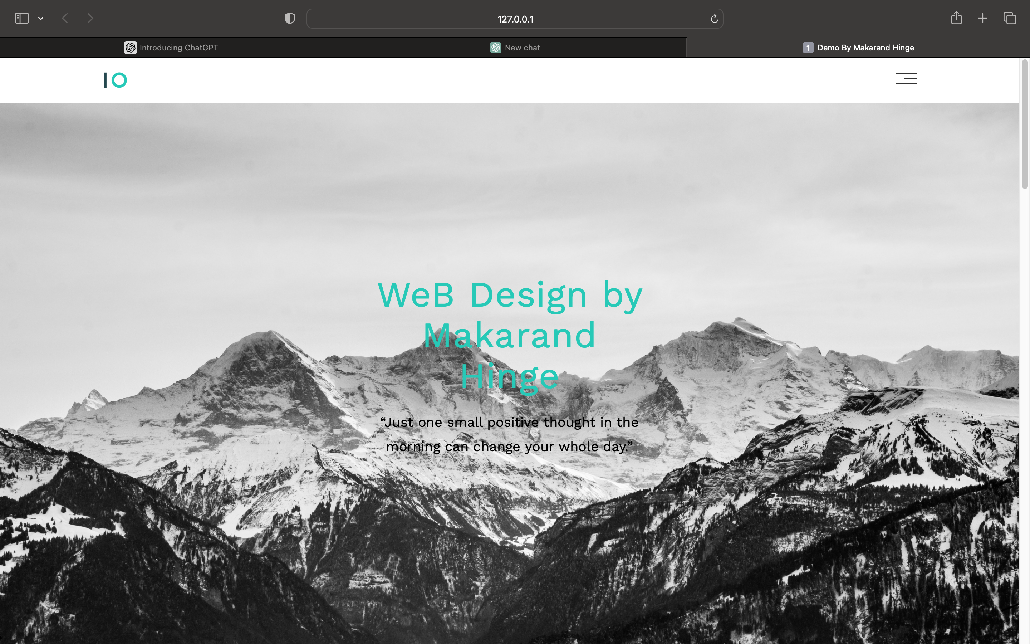
Work Sample

Slide 11
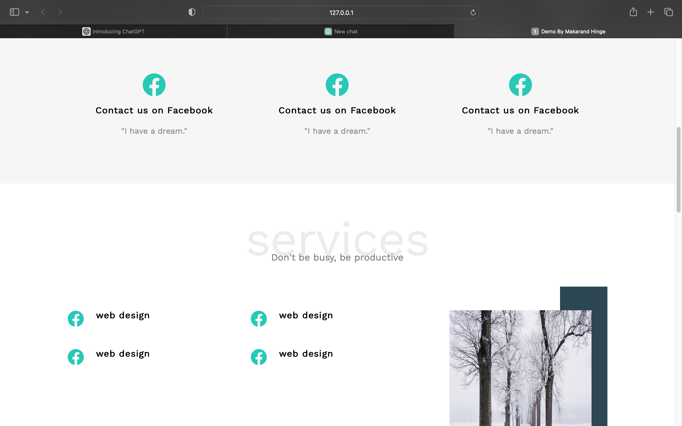

Slide 12
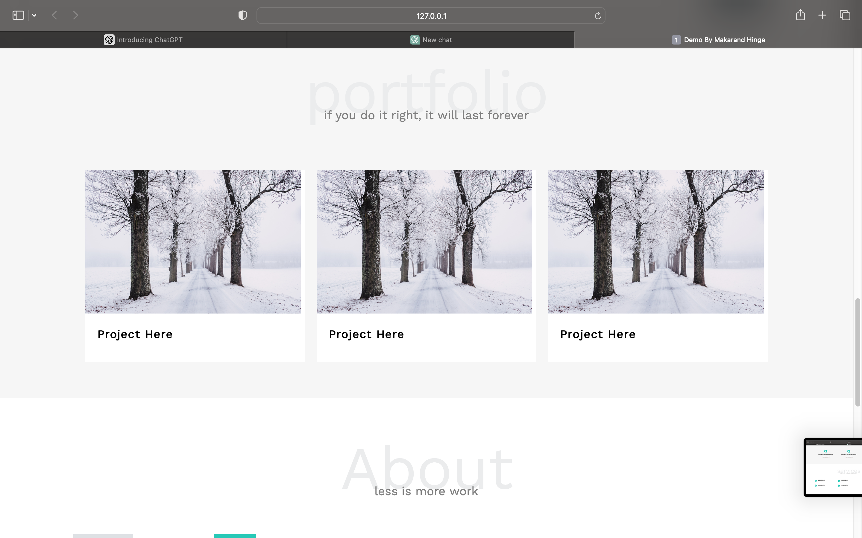
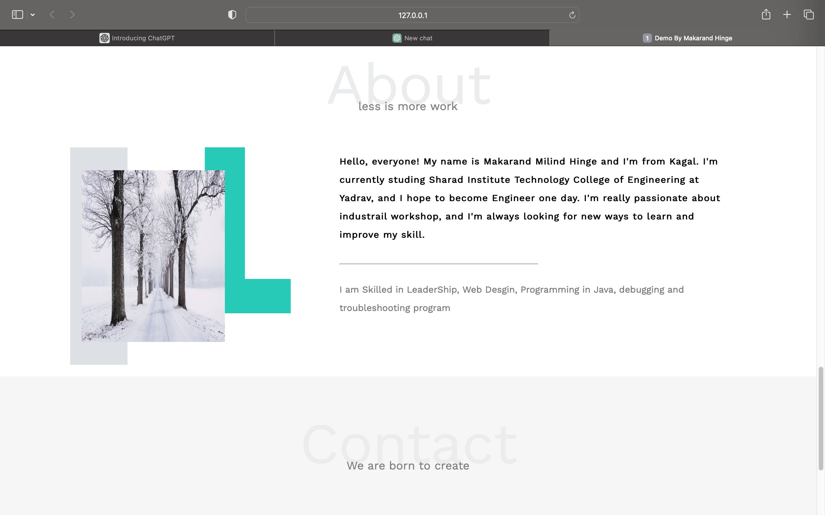

Slide 13
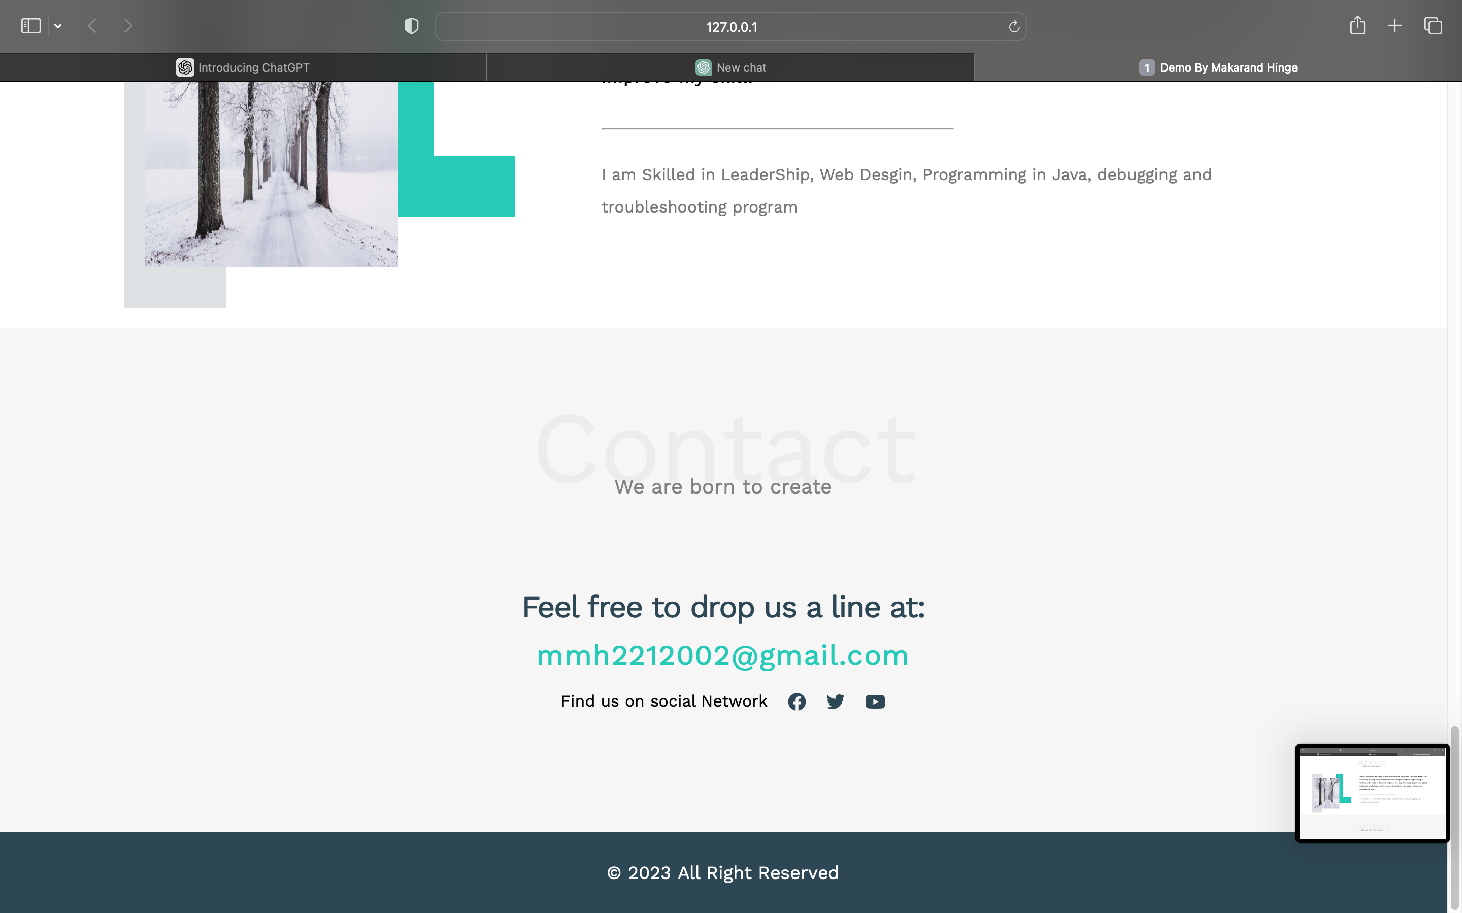

Slide 14
Conclusion
In conclusion, web development is the process of creating and maintaining websites and web applications that are essential for modern businesses to establish an online presence and reach a wider audience.

Slide 15
Thank You

